Slide 1

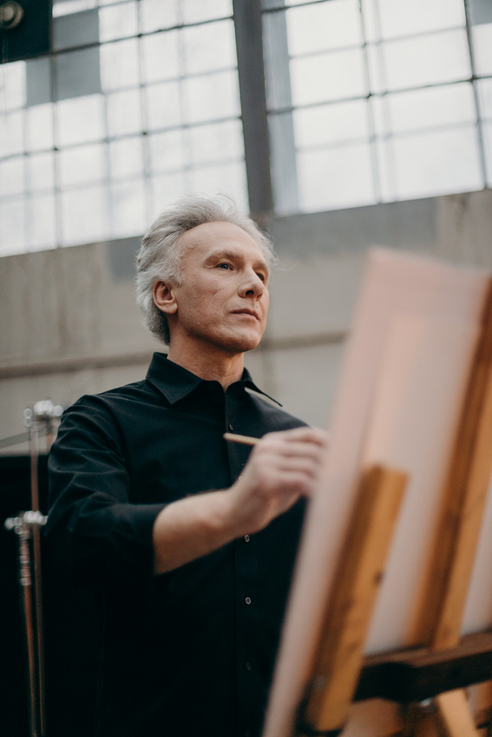
IN LOVING MEMORY OF
Interment
SEPTEMBER 12TH | 10:00 AM
123 ANYWHERE ST.,
ANY CITY, ST 12345
WE'LL REMEMBER HER
AS A LOVING MOTHER, GRANDMOTHER,
AUNT, AND FRIEND.
SIMPLE LUNCH FOLLOWS.
Jamie
Chastain
OCTOBER 06, 1952
- MAY 07, 2023

Slide 2
Order of
Service
THE LITURGY
Sed dictum a urna vitae laoreet. Aliquam sit amet dolor id enim pulvinar iaculis. Suspendisse viverra.
In Memoriam
Thank You
MEMORIAL
Sed dictum a urna vitae laoreet. Aliquam sit amet dolor id enim pulvinar iaculis. Suspendisse viverra, orci non sagittis luctus, nisl eros pulvinar ex, id efficitur tortor massa eget diam. Phasellus volutpat, ligula quis feugiat facilisis, nulla odio semper sem, sed facilisis. Suspendisse viverra, orci non sagittis luctus, nisl eros pulvinar ex, id efficitur tortor massa eget diam.
THANK YOU FOR ALL THE KIND
MESSAGES AND PRAYERS.
Sed dictum a urna vitae laoreet. Aliquam sit amet dolor id enim pulvinar iaculis. Suspendisse viverra.
BLESSING
Sed dictum a urna vitae laoreet. Aliquam sit amet dolor id enim pulvinar iaculis. Suspendisse viverra.
RECESSIONAL
Sed dictum a urna vitae laoreet. Aliquam sit amet dolor id enim pulvinar iaculis. Suspendisse viverra.

